Slide 1
Streaming with Lambda Architecture: OpenSource and Azure stacks

Slide 2
Objectives
Discuss Lambda architecture over OpenSource and Azure stacks
Understand Lambda architecture – Speed and Batch Layers
Open-Source streaming architecture template
Azure as IaaS architecture
Azure & Hybrid stack

Slide 3

Lamda Architecture
Can discard any view, batch and real time, and just recreate everything from the master data
Mistakes are corrected via recompilation:
Write bad data? Remove the data and recompute
Bug in view generation? Just recompute the view
Data storage is highly optimised.
A Real-time architecture using Hadoop & Storm

Slide 4
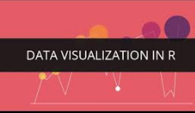

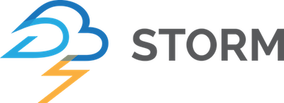
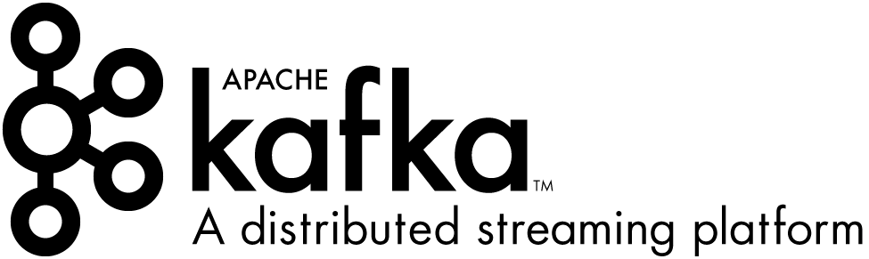
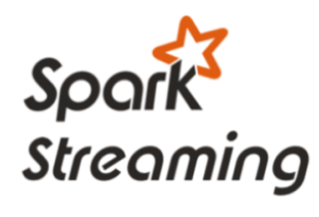

Open Source Big Data Streaming patterns
Ambari Operations Management Suite
Business apps
VNet Boundary
UX
Events
Events
Custom apps
Store
Event Processing
Stream Processing
Achieving
Sensors and devices
Apache Ranger Integration
Notes:
How does HDInsight address Enterprise level problems
Monitoring
OMS value prop
EMPHASIZE E2E

Slide 5










Azure & Hybrid Lambda Architecture
Big Data Stores
Machine Learning & Analytics
Data Consumption
Batch layer
Data Generation
Azure Data Lake
Azure SQL DW
Azure ML
Open R, MRS
SQL
Server
2016
Ad Hoc Dashboards
Databases
Azure Data Factory
Power BI
Cortana
Web App
Excel
Perceptual
Intelligence
Cosmos
DB
Storage Blob
HDFS
Spark
SparkR
Pig
Hadoop Interface
Hive
HBase
Automated Systems
Mahout
Interactive
Hive
APIs
Business Scenarios
Azure Event Hub
Speed layer
Big Data / IoT Sources
Azure Stream Analytics
Power BI
Devices
Data Not Stored
Azure
Web App
Crawlers
Storm
Bots
Azure IoT Hub
Spark
Streaming
Hadoop
Streaming
Interface
Sensors
Legend
 | Regular Azure |  | Cold Path
 | Hadoop via HDInsight |  | Hot Path
Notes:
Cortana Analytics Suite delivers an end-to-end platform with integrated and comprehensive set of tools and services to help you build intelligent applications that let you easily take advantage of Advanced Analytics. Because these technologies offer managed services options, they are extremely cost-effective and rapidly deployable. Compared to legacy data management and data science options, they are extremely inexpensive. This opens the door for rapid development cycles at a low risk & low cost. Fraud Detection & Personalization are examples of how these technologies can be deployed in financial services.
First Cortana Analytics Suite provides services to bring data in, so that you can analyze it. It provides information management capabilities like Azure Data Factory so that you can pull data from any source (relational DB like SQL or non-relational ones like your Hadoop cluster) in an automated and scheduled way, while performing the necessary data transforms (like setting certain data colums as dates vs. currency etc). Think ETL (Extract, Transform, Load) in the cloud. Event hub does the same for IoT type ingestion of data that streams in from lots of end points.
The data brought in then can be persisted in flexible big data storage services like Data Lake and Azure SQL DW.
You can then use a wide range of analytics services from Azure ML to Azure HDInsight to Azure Stream Analytics to analyze the data that are stored in the big data storage. This means you can create analytics services and models specific to your business need (say real time demand forecasting) to harness deep actionable insights.
The resultant analytics services and models created by taking these steps can then be surfaced as interactive dashboards and visualizations via Power BI
These same analytics services and models created can also be integrated into various different UI (web apps or mobile apps or rich client apps) as well as via integrations with Cortana, so end users can naturally interact with them via speech etc., and so that end users can get proactively be notified by Cortana if the analytics model finds a new anomaly (unusual growth in certain product purchases- in the case of real time demand forecasting example given above) or whatever deserves the attention of the business users.

Slide 6
Spark/Kafka/Storm on Azure HDInsight
Fully Managed Service
100% open source Apache Spark and Hadoop bits
Fully supported by Microsoft and Hortonworks
99.9% Azure Cloud SLA
Certifications: PCI, ISO 27018, SOC, HIPAA, EU-MC
Optimized for data exploration, experimentation and development
Jupyter Notebooks (scala, python, automatic data visualizations)
IntelliJ and Eclipse plugins (job submission, remote debugging)
ODBC connector for Power BI, Tableau, Qlik, SAP, Excel, etc
Notes:
ADD SLIDES --

Slide 7
Fully-managed Hadoop and Spark for the cloud. 99.9% SLA
100% Open Source Hortonworks data platform
Clusters up and running in minutes Familiar BI tools, interactive open source notebooks
63% lower TCO than deploy your own Hadoop on-premises* Scale clusters on demand
Secure Hadoop workloads via Active Directory and Ranger
Compliance for Open Source bits Best in class monitoring and predictive operations via OMS Native Integration with leading ISVs
Why consider Azure Stack ?
*IDC study “The Business Value and TCO Advantage of Apache Hadoop in the Cloud with Microsoft Azure HDInsight”

